Slide 1
AI Hedge-Fund
CMF 2025 Step 2:
Yukhnovskiy Yuriy

Slide 2
Hedge Fund Model A Modern Crypto Hedge Fund: Intelligence Over Rules
Our hedge fund model replaces rigid rule-based strategies with adaptive machine learning systems that learn from market dynamics.
Core idea: Use ML not just for prediction, but for continuous policy optimization under changing regimes.

Slide 3
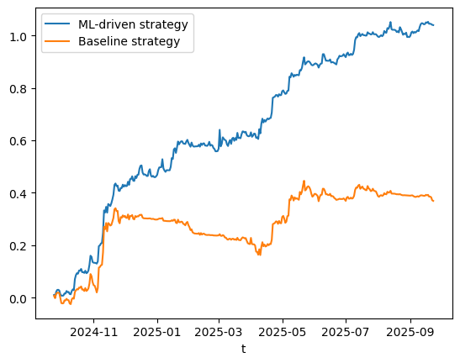
Hedge Fund Model From Classical Signals to Learned Policies
Can classical technical indicators be used?
Yes — but as inputs, not decisions:
Moving average deviations
Volatility regimes
Momentum at multiple time scales (Hann-windowed)
These are engineered into features — not used directly as buy/sell rules.
Which ML algorithms are applicable?
We use:
CatBoostRegressor: Interpretable, handles noisy financial data well, no overfitting on tree depth.
Gaussian Mixture Models (GMM): For synthetic data generation and strategy verifying.
Optuna: Hyperparameter tuning + strategy optimization via Bayesian search.

Slide 4
Hedge Fund Model AI Agents
AI does not make binary trades — it outputs continuous exposure levels (0 to 1), interpreted as fractional long positions.
Decisions are probabilistic:
“How confident are we that price will rise over the next horizon?”
Each asset has its own:
Signal Agent: CatBoost model predicting ideal position
Portfolio Optimization Algorithm: Normalizes signals into dynamic weights
Filter: Applies threshold (via Optuna) to remove weak signals
Signal Agent
Position
Filter algo
Weight
Legend:
Execution
Portfolio algo
Model
Data

Slide 5
Risk Management Key Risk Metrics & Monitoring Strategy
Metric | Purpose
Volatility | Detect high-risk periods (vol > 2-year median)
Max Drawdown | Trigger circuit breakers if > X%
Turnover | Limit transaction costs and churn
Sharpe/Sortino/Calmar Ratio | Track efficiency out-of-sample
Out-of-sample Portfolio results (1 year from 2024-09-23 to 2025-09-023)

Slide 6
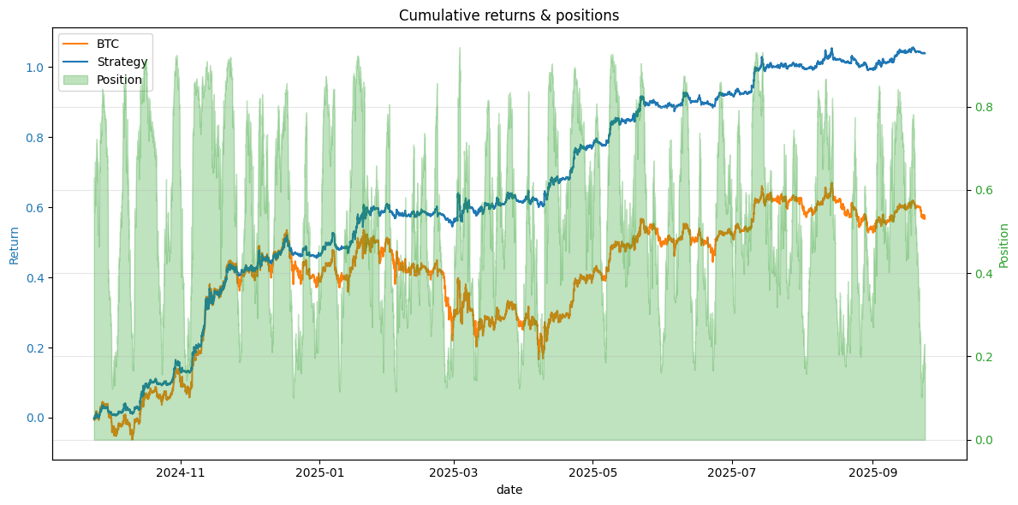
Risk Management AI in Mitigating Losses During Turbulence
Key Insight: The best way to reduce losses? Reduce exposure when uncertain.
How AI helps:
Volatility-aware normalization: Returns scaled by EMA of abs(ret)
Dynamic position clipping: Weak signals → set to zero
Synthetic stress testing: GMM-generated paths simulate crashes
Deflated Sharpe Ratio: Flags overfitting before live deployment

Slide 7
Portfolio Management From Markowitz to Machine Learning Portfolio
What is an optimal portfolio?
Classically: Maximize Sharpe ratio under constraints (Markowitz).
But in crypto:
Covariance matrices unstable
Returns non-Gaussian
Regimes shift rapidly
So we redefine optimality:
“An optimal portfolio maximizes risk-adjusted returns using adaptive, interpretable signals.”
We combine:
Mean-variance ideas (via PyPortfolioOpt)
With signal confidence weighting (ML-driven)

Slide 8
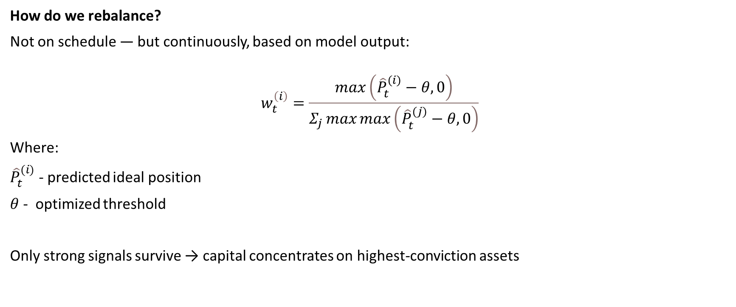
Portfolio Management Dynamic, Signal-Based Rebalancing
How do we rebalance?
Not on schedule — but continuously, based on model output:
$$w_{t}^{\left(i\right)}=\frac{\max\left({\hat{P}}_{t}^{(i)}−θ,0\right)}{Σ_{j}\max{\max\left({\hat{P}}_{t}^{(j)}−θ,0\right)}}$$
Where:
${\hat{P}}_{t}^{(i)}$ - predicted ideal position
$θ$ - optimized threshold
Only strong signals survive → capital concentrates on highest-conviction assets

Slide 9
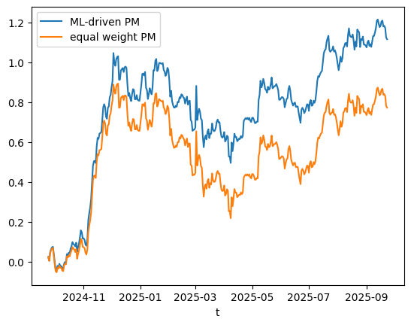
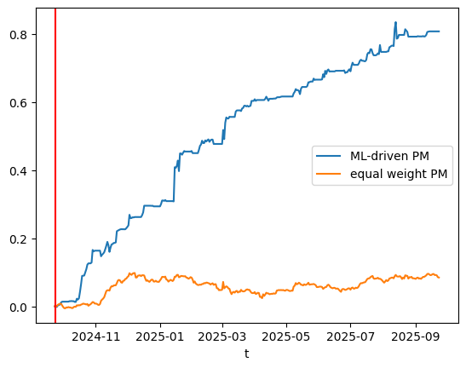
Portfolio Management Why Equal Weight Is Not Enough
Backtest result:
ML-driven portfolio: Outperformed equal-weight benchmark
Especially after applying signal filtering
But high correlation initially → shows need for filtering
Signal Filtering

Slide 10
System Architecture End-to-End AI Trading Architecture
Legend:
Model
Data
Process
Data collection
Feature Engineering
AI agent (Signal Generation)
Per-asset CatBoost models
Signal filtering (Optuna)
Portfolio Management
- Dynamic weight allocation
Execution
- Commissions (0.1%)
Monitoring
- Metrics
Risk Management
- Risk Metrics
Backtesting (optimization)
Synthetic data validation (PSR/DSR)

Slide 11
System Architecture Module Descriptions & Data Flow
Module | Function | Technology Used
Data Collection | Fetch OHLCV from ByBit API | custom "data_downloader.py
Feature Engine | Compute momentum, vol, hurst, etc. | Pandas, Scipy, Sklearn
AI Agents | Predict position per token | CatBoost, Optuna
Portfolio Mgmt | Normalize signals → weights | Custom logic
Risk Mgmt | Monitor drawdown, vol, Sharpe decay | Statistics, GMM sims
Execution | Apply slippage, generate net returns | Vectorized pandas
Monitoring | Plot equity, log stats | Matplotlib, custum formulas

Slide 12
Thank you for your attention
Email: izhvolley@gmail.com
tg: @yukhnovskyyy

